Slide 1
LINKED LISTS

Slide 2
Arrays
An array is a fundamental data structure that stores a collection of elements, each identified by an index or a key. The elements in an array are typically of the same data type, and they are stored in contiguous memory locations. The use of indices allows for easy and efficient access to individual elements.
Here are some key characteristics and concepts related to arrays:
Indexing: Elements in an array are accessed using their index or position within the array. The index usually starts from 0, so the first element is at index 0, the second at index 1, and so on.
Fixed Size: In most programming languages, the size of an array is fixed at the time of declaration. Once the size is specified, it typically cannot be changed during the program's execution. However, some languages provide dynamic arrays or resizable arrays to overcome this limitation.
Contiguous Memory Allocation: The elements of an array are stored in adjacent memory locations. This contiguous memory allocation allows for efficient access to elements through direct indexing.
Homogeneous Elements: Arrays are designed to store elements of the same data type. This means that all elements within an array should be of the same type (e.g., integers, floating-point numbers, characters).

Slide 3
Types of array
Arrays can be categorized into different types based on their dimensions, data types, and how they are accessed. Here are some common types of arrays:
1. One-Dimensional Array:
An array that stores elements in a linear sequence.
Elements are accessed using a single index.
Declaration and initialization
Data_type array_name[size];
Int age[5];
Int age[5] = {5,6,7,8,9};

Slide 4
Two-Dimensional Array:
An array with two dimensions, often represented as a matrix with rows and columns.
Elements are accessed using two indices.
Declaration and initialization
Data_type Array_name[rowsize][columnsize];
Int a[2][3];
Int a[2][3] = {{1,2,3},
{4,5,6}};

Slide 5
Multi-Dimensional Array:
An array with more than two dimensions.
Examples include three-dimensional arrays, four-dimensional arrays, and so on.
Accessing elements requires specifying multiple indices.
Eg;
int a[2][3][4];
Plane row column

Slide 6
Array as an abstract Data type
An array can be conceptualized as an abstract data type (ADT), providing a high-level description of its functionality without specifying the implementation details. As an abstract data type, an array is defined by its behavior and the operations that can be performed on it, rather than the specific way it is stored in memory. Here are the essential characteristics and operations associated with an array as an abstract data type:
Attributes:
Elements: The data values stored in the array.
Size: The number of elements in the array, which is typically fixed at the time of creation for static arrays.
Operations:
Create(ArraySize): Initializes an array with a specified size.
Get(index): Returns the value at a given index in the array.
Set(index, value): Modifies the value at a specified index.
Size(): Returns the size (number of elements) of the array.
Insert(index, value): Inserts a new element at the specified index, shifting existing elements to accommodate the new one.
Delete(index): Removes the element at the specified index, shifting remaining elements to fill the gap.
Search(value): Locates the index of a given value within the array.
Sort(): Arranges the elements in a specific order (e.g., ascending or descending).
Resize(newSize): Adjusts the size of the array. This operation is common in dynamic arrays.

Slide 7
List and ADT
A List is a linear data structure that organizes elements in a sequential order, allowing for easy insertion, deletion, and traversal.
The Abstract Data Type (ADT) definition for a list describes the behavior and operations of a list without specifying the implementation details. The ADT for a list typically includes the following operations:
CreateList:
Creates an empty list.
Insert:
Inserts an element at a specified position in the list.
Delete:
Removes an element from the list at a specified position.

Slide 8
Retrieve/Get:
Retrieves the element at a specified position in the list.
IsEmpty:
Checks if the list is empty.
Size/Length:
Returns the number of elements in the list.
Search:
Searches for a specified element in the list and returns its position if found.
Traverse:
Visits each element in the list one by one.
The ADT definition abstracts away the implementation details and focuses on what operations a list should support and what behavior is expected from those operations. Different implementations, such as arrays, linked lists, or other data structures, can fulfill the requirements of the list ADT.

Slide 9
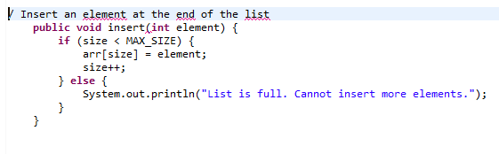
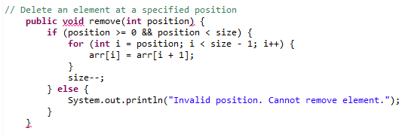
Array implementation of list
Inserting a element in a list
Deleting a element in a list

Slide 10
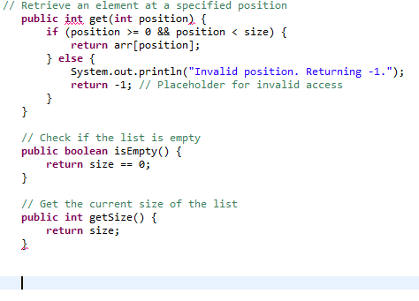
Get the element from the list

Slide 11
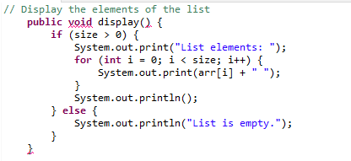
Display the element of the list

Slide 12
An array is a very useful data structure provided in programming languages. However, it has at least two limitations:
(1) changing the size of the array requires creating a new array and then copying all data from the array with the old size to the array with the new size.
(2) the data in the array are next to each other sequentially in memory, which means that inserting an item inside the array requires shifting some other data in this array.
This limitation can be overcome by using linked structures. A linked structure is a collection of nodes storing data and links to other nodes
A linked list is a linear data structure that stores a collection of data elements dynamically.

Slide 13
A linked list consists of a data element known as a node. And each node consists of two fields:
one field has data,
second field of the node has an address that keeps a reference to the next node.
The last node contains null in its second field because it will point to no node.
A linked list can grow and shrink its size, as per the requirement.
It does not waste memory space.

Slide 14
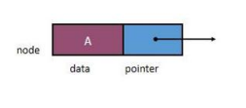

Slide 15
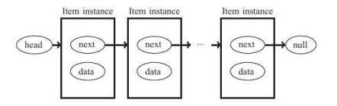
LINK LIST REPRESENTATION
The linked list instance must keep a reference to the first node of the list, known as the head.
The last node of the list is known as the tail.
The tail of a list can be found by traversing the linked list— starting at the head and moving from one node to another by following each node’s next reference. We can identify the tail as the node having null as its next reference.
each node consists of the data element and a link to the next node in the list.
A header node is an extra node in a linked list that holds no data but serves to satisfy the requirement that every node containing an item have a previous node in the list.

Slide 16
Advantages Of Linked List:
Dynamic data structure: A linked list is a dynamic arrangement so it can grow and shrink at runtime by allocating and deallocating memory. So there is no need to give the initial size of the linked list.
No memory wastage: In the Linked list, efficient memory utilization can be achieved since the size of the linked list increase or decrease at run time so there is no memory wastage and there is no need to pre-allocate the memory.
Implementation: Linear data structures like stacks and queues are often easily implemented using a linked list.
Insertion and Deletion Operations: Insertion and deletion operations are quite easier in the linked list. There is no need to shift elements after the insertion or deletion of an element only the address present in the next pointer needs to be updated.
Flexible: This is because the elements in Linked List are not stored in contiguous memory locations unlike the array.
Efficient for large data: When working with large datasets linked lists play a crucial role as it can grow and shrink dynamically.
Scalability: Contains the ability to add or remove elements at any position.

Slide 17
Disadvantages Of Linked List:
Memory usage: More memory is required in the linked list as compared to an array. Because in a linked list, a pointer is also required to store the address of the next element and it requires extra memory for itself.
Traversal: In a Linked list traversal is more time-consuming as compared to an array. Direct access to an element is not possible in a linked list as in an array by index. For example, for accessing a node at position n, one has to traverse all the nodes before it.
Reverse Traversing: In a singly linked list reverse traversing is not possible, but in the case of a doubly-linked list, it can be possible as it contains a pointer to the previously connected nodes with each node. For performing this extra memory is required for the back pointer hence, there is a wastage of memory.
Random Access: Random access is not possible in a linked list due to its dynamic memory allocation.
Lower efficiency at times: For certain operations, such as searching for an element or iterating through the list, can be slower in a linked list.
Complex implementation: The linked list implementation is more complex when compared to array. It requires a complex programming understanding.

Slide 18
Difference between Array and Linked List
ARRAY | LINKED LIST
An array is a grouping of data elements of equivalent data type. | A linked list is a group of entities called a node. The node includes two segments: data and address.
It stores the data elements in a contiguous memory zone. | It stores elements randomly, or we can say anywhere in the memory zone.
In the case of an array, memory size is fixed, and it is not possible to change it during the run time. | In the linked list, the placement of elements is allocated during the run time.
The elements are not dependent on each other. | The data elements are dependent on each other
The memory is assigned at compile time. | The memory is assigned at run time
It is easier and faster to access the element in an array. | In a linked list, the process of accessing elements takes more time
In the case of an array, memory utilization is ineffective | In the case of the linked list, memory utilization is effective

Slide 19
Applications of linked list in computer science:
Implementation of stacks and queues
Implementation of graphs: Adjacency list representation of graphs is the most popular which uses a linked list to store adjacent vertices.
Dynamic memory allocation: We use a linked list of free blocks.
Maintaining a directory of names
Performing arithmetic operations on long integers
Manipulation of polynomials by storing constants in the node of the linked list

Slide 20
Applications of linked list in the real world:
Image viewer – Previous and next images are linked and can be accessed by the next and previous buttons.
Previous and next page in a web browser – We can access the previous and next URL searched in a web browser by pressing the back and next buttons since they are linked as a linked list.
Music Player – Songs in the music player are linked to the previous and next songs. So you can play songs either from starting or ending of the list.
GPS navigation systems- Linked lists can be used to store and manage a list of locations and routes, allowing users to easily navigate to their desired destination.
Robotics- Linked lists can be used to implement control systems for robots, allowing them to navigate and interact with their environment.
Task Scheduling- Operating systems use linked lists to manage task scheduling, where each process waiting to be executed is represented as a node in the list.
Image Processing- Linked lists can be used to represent images, where each pixel is represented as a node in the list.

Slide 21
Types of Linked List:
basically, we can put linked list into the following types:
Singly linked list
doubly linked list
circular linked list
Singly circular link list
Doubly circular linked list

Slide 22
SINGLY LINKED LIST
A singly linked list is a dynamic data structure which may grow or shrink, and growing and shrinking depends on the operation made.
In this type of linked list each node contains two fields one is info field which is used to store the data items and another is link field that is used to point the next node in the list. The last node has a NULL pointer.
The NULL value of the next field of the linked list indicates the last node and we define macro for NULL and set it to 0 as below:
#define NULL 0

Slide 23

The following example is a singly linked list that contains three elements 5, 3, 8.

Slide 24
OPERATIONS ON SINGLY LINKED LIST
Node creation
Node insertion
From the Beginning
From the specified position
From the end
Node deletion
From the Beginning
From the specified position
From the end

Slide 25
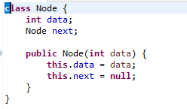
Node creation
Algorithm:
Create a class Node with fields for data and a reference to the next node.
In the Node class, create a constructor to initialize the data and set the next node reference to null.
Function to create a node

Slide 26
NODE INSERTION
At the beginning
Algorithm to insert node at the beginning:
Create a new node with the given data.
If the linked list is empty (head is null):
Set the new node as the head.
If the linked list is not empty:
Set the next field of the new node to the current head.
Update the head to be the new node.

Slide 27
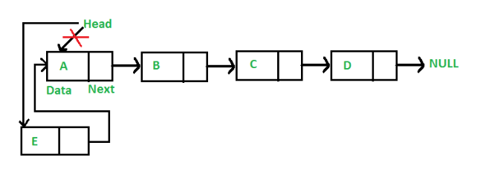

Slide 28
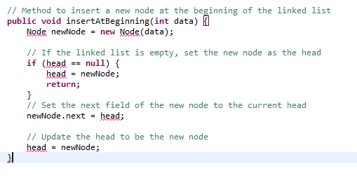
Function to add node at the beginning

Slide 29
2. At the end
Algorithm to insert node at the end
Create a new node with the given data.
If the linked list is empty (head is null):
Set the new node as the head.
If the linked list is not empty:
Traverse the list to find the last node.
Set the next field of the last node to the new node.

Slide 30
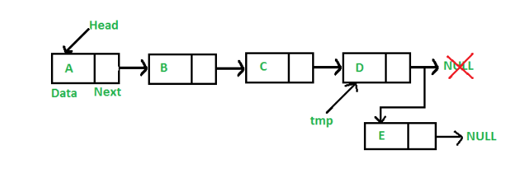

Slide 31
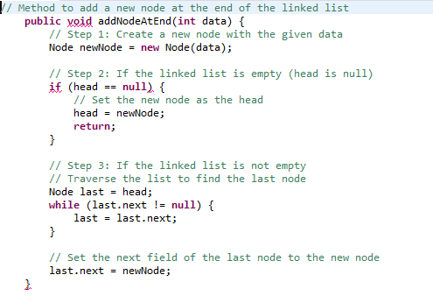
Function to add node at the end

Slide 32
3. At the specified position
Algorithm to insert node at specified position
Create a new node with the given data.
If the specified position is 0:
Set the next field of the new node to the current head.
Update the head to be the new node.
If the specified position is greater than 0:
Traverse the list to find the node at position - 1.
Set the next field of the new node to the next field of the node at position - 1.
Set the next field of the node at position - 1 to the new node.

Slide 33
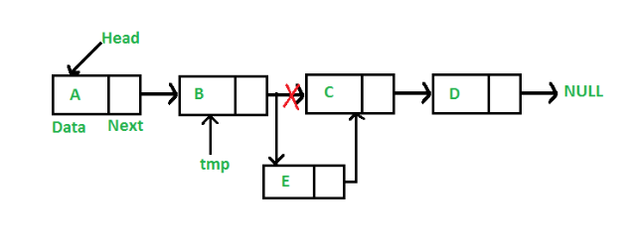

Slide 34
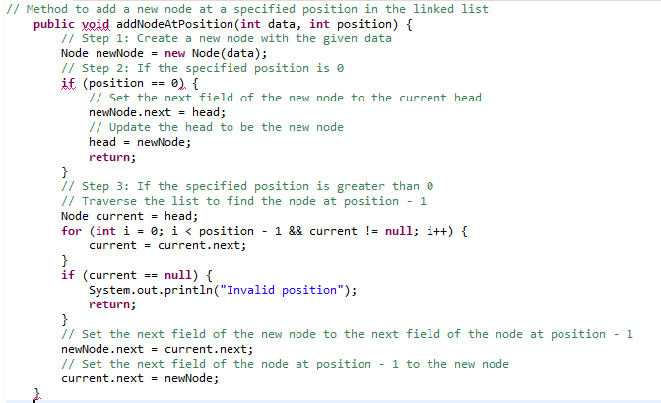

Slide 35
NODE DELETION
At the beginning of the linked list
Algorithm:
If the linked list is empty (head is null):
Display an error message (optional, depends on the design).
If the linked list is not empty:
Update the head to be the next node of the current head.

Slide 36
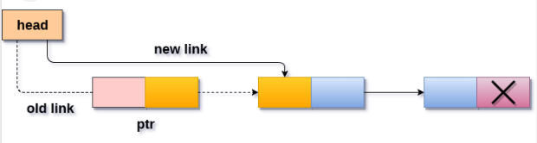

Slide 37
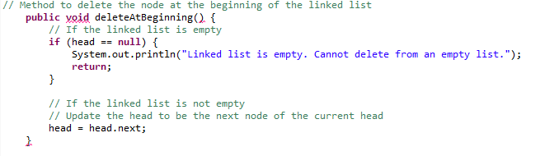
Function to delete from beginning

Slide 38
FROM THE END
Algorithm:
If the linked list is empty (head is null):
Display an error message (optional, depends on the design).
If the linked list has only one node:
Set the head to null.
If the linked list has more than one node:
Traverse the list to find the second-to-last node.
Set the next field of the second-to-last node to null.

Slide 39
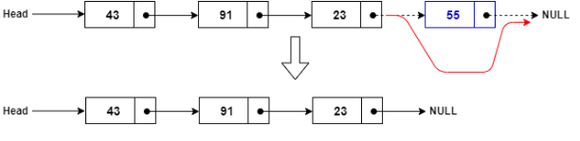

Slide 40
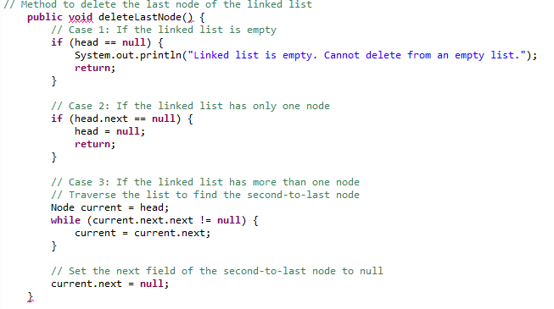

Slide 41
FROM THE SPECIFIED POSITION
Algorithm:
If the linked list is empty (head is null):
Display an error message (optional, depends on the design).
If the specified position is 0:
Update the head to be the next node of the current head.
If the specified position is greater than 0:
Traverse the list to find the node at position - 1.
If the node at position - 1 is null (invalid position), display an error message (optional).
If the node at position - 1 is not null, set its next field to the next field of the node at position - 1.

Slide 42
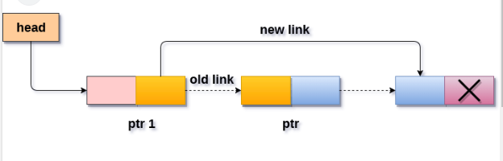

Slide 43
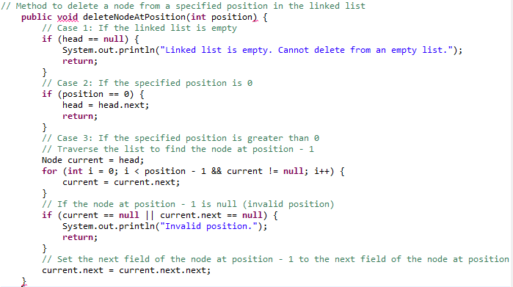

Slide 44
DOUBLY LINKED LIST/TWO WAY LINKED LIST
A doubly linked list is a data structure in which each element, known as a node, contains a data part and two pointers.
The two pointers are typically named "next" and "prev," and they point to the next and previous nodes in the sequence, respectively.
This structure allows traversal in both forward and backward directions.

Slide 45
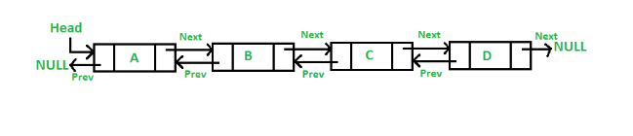
Data: The actual data or value stored in the node.
Prev: A pointer to the previous node in the sequence.
Next: A pointer to the next node in the sequence.

Slide 46
Advantages of Doubly Linked List over the singly linked list:
A DLL can be traversed in both forward and backward directions.
The delete operation in DLL is more efficient if a pointer to the node to be deleted is given.
We can quickly insert a new node before a given node.
In a singly linked list, to delete a node, a pointer to the previous node is needed. To get this previous node, sometimes the list is traversed. In DLL, we can get the previous node using the previous pointer.
Disadvantages of Doubly Linked List over the singly linked list:
Every node of DLL Requires extra space for a previous pointer.
All operations require an extra pointer previous to be maintained. For example, in insertion, we need to modify previous pointers together with the next pointers.

Slide 47
Applications of Doubly Linked List:
It is used by web browsers for backward and forward navigation of web pages
LRU ( Least Recently Used ) / MRU ( Most Recently Used ) Cache are constructed using Doubly Linked Lists.
Used by various applications to maintain undo and redo functionalities.
In Operating Systems, a doubly linked list is maintained by thread scheduler to keep track of processes that are being executed at that time.

Slide 48
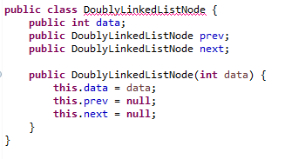
Representation

Slide 49
NODE INSERTION
At the beginning
algorithm
Create a new node with the given data.
first checks whether the head is null, then insert the node as the head.
Both head and tail will point to a newly added node.
Head's previous pointer will point to null and tail's next pointer will point to null.
If the head is not null, head's previous will point to new node.
Make new node as head of the list.
Since new node became head so its previous should point to null.

Slide 50
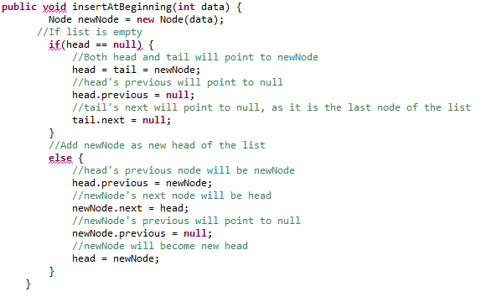

Slide 51
At the end
Algorithms
Create a new node (say new_node).
Put the value in the new node.
Make the next pointer of new_node as null.
If the list is empty, make new_node as the head.
Otherwise, travel to the end of the linked list.
Now make the next pointer of last node point to new_node.
Change the previous pointer of new_node to the last node of the list.

Slide 52
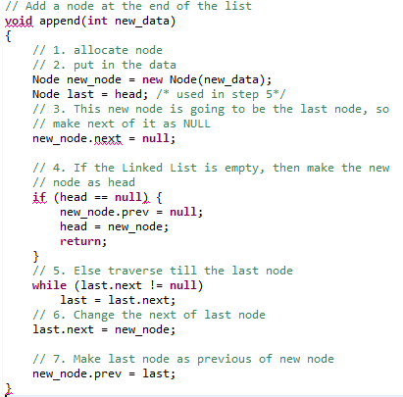

Slide 53
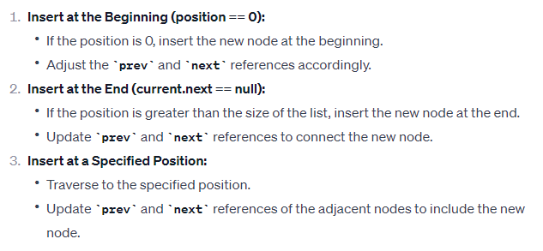
At the specified position
Algorithm

Slide 54
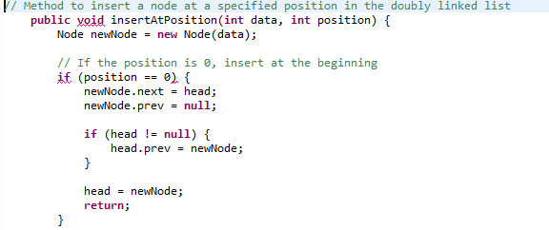

Slide 55
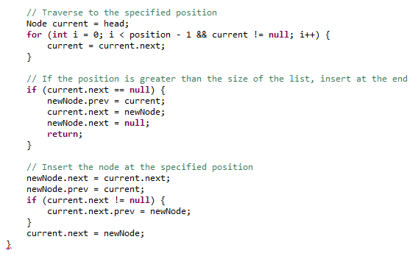

Slide 56
DELETION
From the beginning
Algorithm:
If the list is empty, there is nothing to delete. Return.
If the list has only one node, set the head to null.
If the list has more than one node:
Update the next reference of the second node (new head) to null.
b. Update the prev reference of the new head to null.
c. Update the head to be the second node.

Slide 57
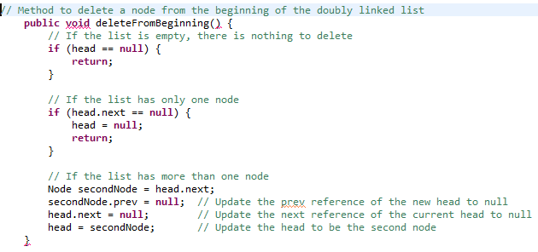

Slide 58
From the end
Algorithm
Check if the list is empty:
If head is null, the list is empty, and there is nothing to delete. Return from the function.
Check if there is only one node in the list:
If head is equal to tail, there is only one node in the list. Set both head and tail to null and return from the function.
Traverse the list to find the last node:
Initialize a pointer current to the head of the list.
Move current to the next node until current.next is null. This will make current point to the last node.
Delete the last node:
Set current.prev.next to null to detach the last node from the list.
Update the tail pointer:
Set tail to current.prev to make the previous node the new last node.

Slide 59
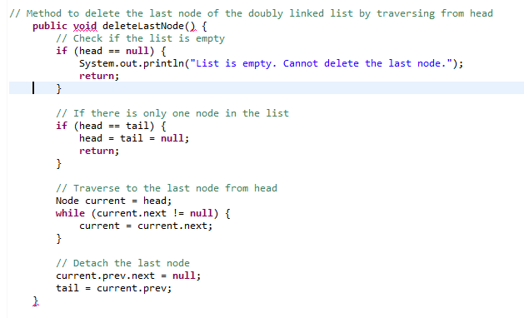

Slide 60
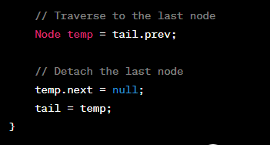
Note: When traversing from back

Slide 61
From specified position
If the doubly linked list is empty, print "The list is empty" and return.
2. If the specified position is less than or equal to 0, print "Invalid position" and return.
3. Set a pointer 'current' to the head of the list.
4. Traverse to the specified position in the list:
a. Iterate from 1 to (position - 1):
i. Move 'current' to the next node.
ii. If 'current' becomes null, print "Position out of bounds" and return.

Slide 62
5. Adjust pointers to delete the node at the specified position:
a. If 'current.prev' is not null, set 'current.prev.next' to 'current.next'.
b. If 'current.next' is not null, set 'current.next.prev' to 'current.prev'.
c. If 'current.prev' is null, update the head of the list to 'current.next'.
d. If 'current.next' is null, update the tail of the list to 'current.prev'.

Slide 63
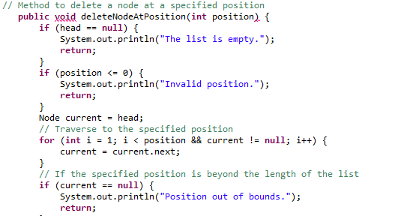

Slide 64
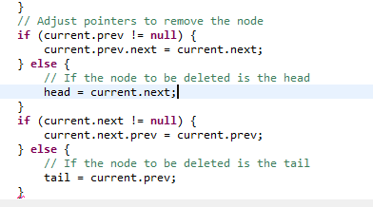

Slide 65
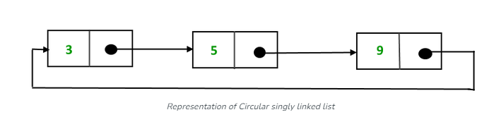
Circular linked list
A circular linked list is a variation of a linked list in which the last node of the list points back to the first node, forming a loop or circle.
Unlike a regular linked list, where the last node typically points to NULL or is considered the end of the list, a circular linked list has no distinct end.
There are generally two types of circular linked lists:
Circular singly linked list: In a circular Singly linked list, the last node of the list contains a pointer to the first node of the list. We traverse the circular singly linked list until we reach the same node where we started. The circular singly linked list has no beginning or end. No null value is present in the next part of any of the nodes.

Slide 66
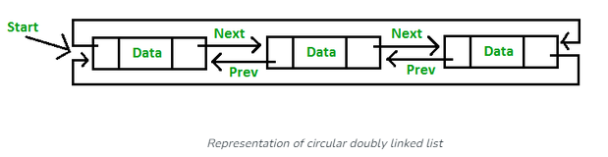
Circular Doubly linked list: Circular Doubly Linked List has properties of both doubly linked list and circular linked list in which two consecutive elements are linked or connected by the previous and next pointer and the last node points to the first node by the next pointer and also the first node points to the last node by the previous pointer

Slide 67
In a circular linked list, there isn't a distinct "start" or "end" as you would find in a traditional linked list. Instead, you can arbitrarily choose any node as the starting point, and the list continues in a circular manner. Similarly, there is no unique "end" because the last node in the list points back to the first node, forming a loop.
However, in programming, it's common to designate one node as the starting point, often called the "head" of the circular linked list.
When traversing or manipulating a circular linked list, it's essential to decide on a starting point (head) and use that as a reference to navigate through the rest of the nodes in the circular manner.
Since a circular linked list forms a loop, there isn't a distinct "end" as you would find in a linear list. However, you can set a condition to stop traversing when you reach the starting point (head) again.

Slide 68
Advantages of Circular Linked Lists:
Circular Structure: Easy traversal from the last node back to the first.
Efficient Insertion/Deletion: Particularly at the beginning of the list.
Implementation of Circular Buffer: Useful for managing fixed-size buffers.
Memory Utilization: Can be more memory-efficient in specific situations.
Disadvantages of Circular Linked Lists:
Complexity in Traversal: Traversal requires careful handling to avoid infinite loops.
Lack of Direct Access: No direct access to nodes; traversal is necessary.
Increased Overhead: Circular connections add implementation complexity.
Difficulty in Reversing: Reversing the list is more complex than in linear linked lists.
Potential for Infinite Loop: Incorrect stopping conditions can lead to infinite loops.

Slide 69
Applications of Circular Linked Lists:
Round-Robin Scheduling:
Used in operating systems for fair process scheduling.
Managing Players in a Game:
Represents a sequence of players in turn-based games.
Music Playlist:
Suitable for continuous playback of songs in playlists.
Cyclic Buffer in Data Streaming:
Implements cyclic buffers for data streaming or communication.
Resource Allocation in Networking:
Manages resource allocation in networking scenarios.
Undo/Redo Functionality:
Used for implementing undo/redo functionality in applications.
Clockwise and Anticlockwise Navigation:
Enables navigation in both directions, e.g., in image viewers.
Memory Allocation Algorithms:
Applied in memory allocation algorithms, especially in garbage collection.

Slide 70
Operations on singly circular linked list
Insertion at the beginning
Algorithm
1. Create a new node newNode and set its data to the given value.
2. If the list is empty (head is null):
a. Set newNode's next pointer to itself.
b. Set the head of the list to newNode.
3. Else:
a. Traverse the list to find the last node (lastNode).
b. Set newNode's next pointer to the current head.
c. Set lastNode's next pointer to newNode.
d. Set the head of the list to newNode.

Slide 71
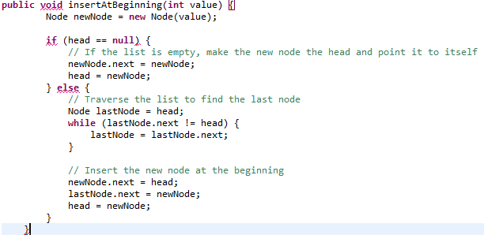

Slide 72
Insertion at the end
ALGORITHM
1. Create a new node newNode and set its data to the given value.
2. If the list is empty (head is null):
a. Set newNode's next pointer to itself.
b. Set the head of the list to newNode.
3. Else:
a. Traverse the list to find the last node (lastNode).
b. Set the next pointer of lastNode to newNode.
c. Set the next pointer of newNode to the head.

Slide 73
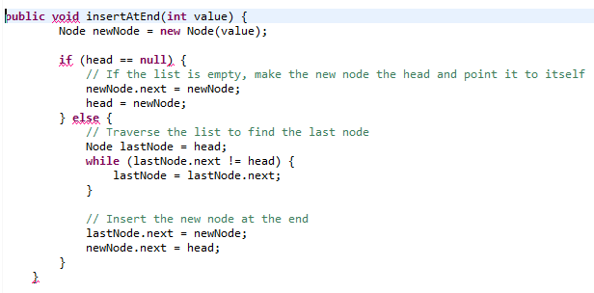

Slide 74
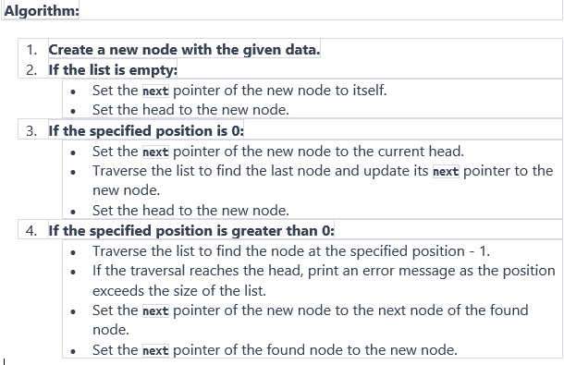
Insertion at specified position

Slide 75
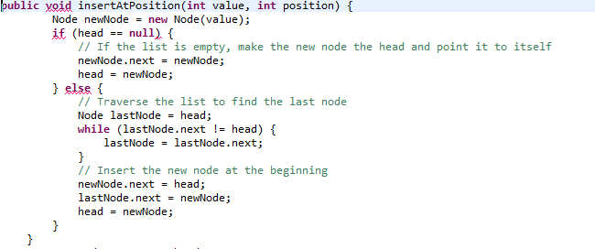

Slide 76
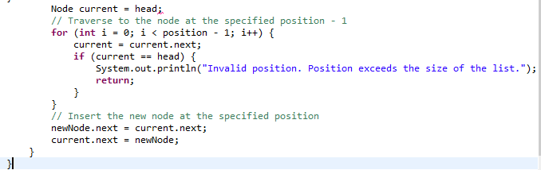

Slide 77
DELETING A NODE A SINGLY CIRCULAR LINKED LIST
FROM THE BEGINNING
Algorithm:
Check if the list is empty. If true, print an error message and return.
If the list has only one node:
Set the head to null.
Otherwise:
Traverse the list to find the last node.
Update the next pointer of the last node to point to the second node.
Set the head to the next node of the current head.

Slide 78
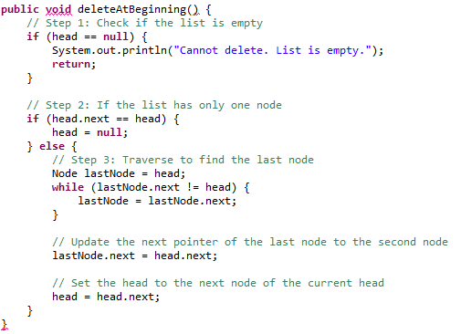

Slide 79
At the end
Algorithm:
Check if the list is empty. If true, print an error message and return.
If the list has only one node:
Set the head to null.
Otherwise:
Traverse the list to find the node just before the last node.
Update the next pointer of the found node to point to the head.
Update the head to be the node following the found node.

Slide 80
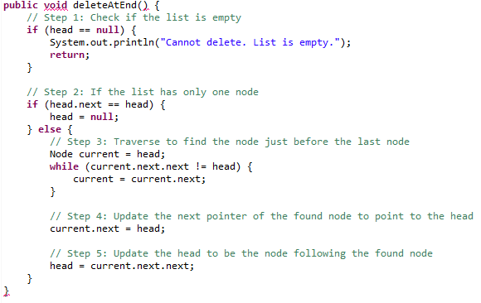

Slide 81
From the specified position
Algorithm:
Check if the list is empty. If true, print an error message and return.
If the specified position is 0:
If the list has only one node, set the head to null.
Otherwise, find the last node, update its next pointer, and set the head to the next node.
Otherwise:
Traverse the list to find the node at the specified position - 1.
If the traversal reaches the head, print an error message as the position exceeds the size of the list.
Update the next pointer of the found node to skip the node at the specified position.

Slide 82
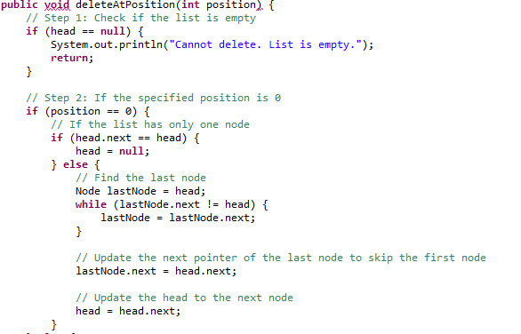

Slide 83
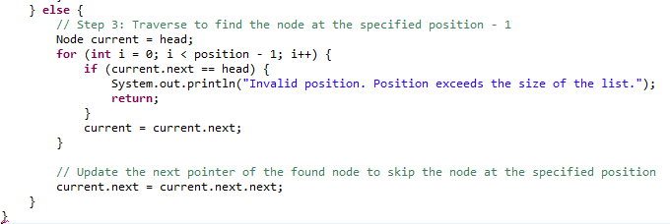

Slide 84
Operations on doubly circular linked list
Insertion at beginning
Algorithm:
Create a new node with the given data.
If the list is empty:
Set the next and previous pointers of the new node to itself.
Set the head and tail to the new node.
If the list is not empty:
Set the next pointer of the new node to the current head.
Set the previous pointer of the new node to the current tail.
Update the next pointer of the current head to point to the new node.
Update the previous pointer of the current tail to point to the new node.
Set the head to the new node.

Slide 85
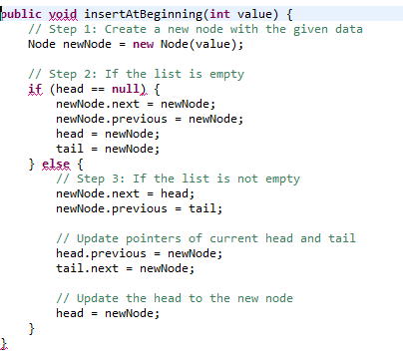

Slide 86
Insertion at the end
Algorithm:
Create a new node with the given data.
If the list is empty:
Set both the next and previous pointers of the new node to itself.
Set the head and tail to the new node.
If the list is not empty:
Set the next pointer of the new node to the head.
Set the previous pointer of the new node to the current tail.
Update the next pointer of the current tail to point to the new node.
Update the previous pointer of the head to point to the new node.
Update the tail to the new node.

Slide 87
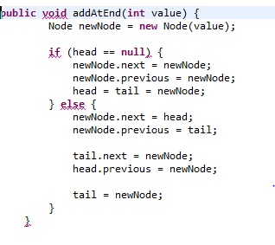

Slide 88
Insertion at the specified position
Algorithm:
Create a new node with the given data.
If the list is empty:
Set both the next and previous pointers of the new node to itself.
Set the head and tail to the new node.
If the specified position is 0:
If the list has only one node, set the head and tail to the new node.
Otherwise, set the next pointer of the new node to the head.
Set the previous pointer of the new node to the current tail.
Update the next pointer of the current tail to point to the new node.
Update the previous pointer of the head to point to the new node.
Update the head to the new node.
If the specified position is greater than 0:
Traverse the list to find the node at the specified position - 1.
If the traversal reaches the head, print an error message as the position exceeds the size of the list.
Set the next pointer of the new node to the next node of the found node.
Set the previous pointer of the new node to the found node.
Update the next pointer of the found node to point to the new node.
Update the previous pointer of the next node of the found node to point to the new node.

Slide 89
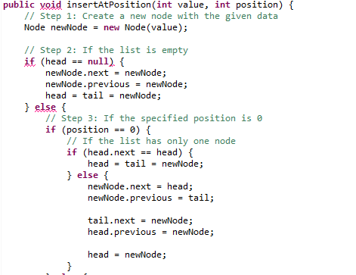

Slide 90
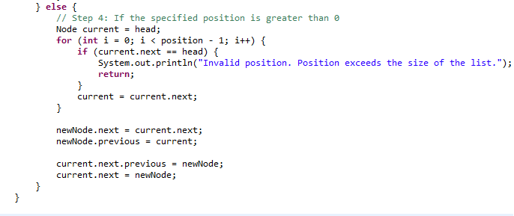

Slide 91
Deletion from the beginning
Algorithm:
Check if the list is empty. If true, print an error message and return.
If the list has only one node:
Set both the head and tail to null.
Otherwise:
Set the next pointer of the head's next node to the current tail.
Set the previous pointer of the tail to the head's next node.
Update the head to the head's next node.

Slide 92
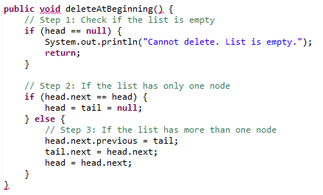

Slide 93
Deletion from the end
Algorithm:
Check if the list is empty. If true, print an error message and return.
If the list has only one node:
Set both the head and tail to null.
Otherwise:
Set the previous pointer of the tail's previous node to the current head.
Set the next pointer of the current head to the tail's previous node.
Update the tail to the tail's previous node.

Slide 94
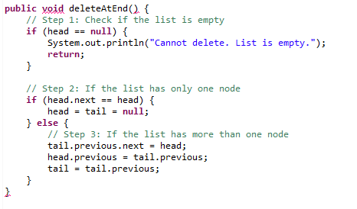

Slide 95
Delete from an specified position
Algorithm:
Check if the list is empty. If true, print an error message and return.
If the specified position is 0:
If the list has only one node, set both the head and tail to null.
Otherwise, set the next pointer of the head's next node to the current tail.
Set the previous pointer of the tail to the head's next node.
Update the head to the head's next node.
If the specified position is greater than 0:
Traverse the list to find the node at the specified position.
If the traversal reaches the head, print an error message as the position exceeds the size of the list.
Set the next pointer of the found node's previous node to the next node of the found node.
Set the previous pointer of the next node of the found node to the previous node of the found node.

Slide 96
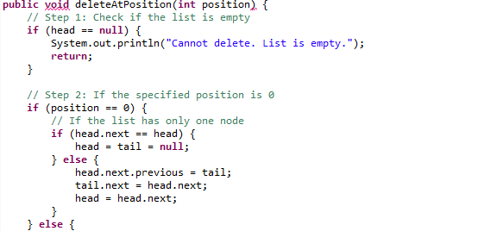

Slide 97
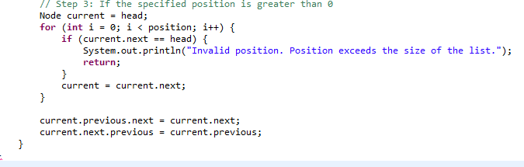

Slide 98
Skip list
Linked lists have one serious drawback: They require sequential scanning to search a element. The search starts from the beginning of the list and stops when either a element is found or the end of the list is reached without finding this element.
Ordering elements on the list can speed up searching, but a sequential search is still required. Therefore, we may think about lists that allow for skipping certain nodes to avoid sequential processing.
A skip list is an interesting variant of the linked list that maintains a sorted collection of elements with efficient search, insertion, and deletion operations.

Slide 99

In a skip list of n nodes,
Half of the nodes have just one reference field,
one-fourth of the nodes have two reference fields,
one-eighth of the nodes have three reference fields, and so on.
The number of reference fields indicates the level of each node,

Slide 100
For 15 elements, the required number of nodes on
level one is eight,
on level two is four,
on level three is two,
and in level four is one.
Each time a node is inserted, a random number r between 1 and 15 is generated, and if r < 9, then a node of level one is inserted. If r < 13, a second-level node is inserted, if r < 15, it is a third-level node, and if r = 15, the node of level four is generated and inserted

Slide 101
if we look for number 16 in the list in Figure b, then level four is tried first, which is unsuccessful because the first node on this level has 28.
Next, we try the third-level sublist starting from the root: It first leads to 8 and then to 17. Hence, we try the second-level sublist that originates in the node holding 8: It leads to 10 and then again to 17.
The last try is by starting the first-level sublist, which begins in node 10; this sublist’s first node has 12, the next number is 17, and because there is no lower level, the search is pronounced unsuccessful

Slide 102

Representation of node

Slide 103
Advantages of the Skip list
If you want to insert a new node in the skip list, then it will insert the node very fast because there are no rotations in the skip list.
The skip list is simple to implement as compared to the hash table and the binary search tree.
It is very simple to find a node in the list because it stores the nodes in sorted form.
The skip list algorithm can be modified very easily in a more specific structure, such as indexable skip lists, trees, or priority queues.
The skip list is a robust and reliable list.
Disadvantages of the Skip list
It requires more memory than the balanced tree.
Reverse searching is not allowed.
The skip list searches the node much slower than the linked list

Slide 104
Applications of skip list
Database Indexing: Efficiently maintains indexes for fast data retrieval in databases.
File Systems: Facilitates quick search and insertion of file entries in file systems.
In-Memory Databases: Stores and indexes data efficiently in main memory for rapid access.
Network Routing Tables: Used for quick lookups of destination addresses in networking.
Search Engines: Implements sorted indexes for web pages or documents in search engine data structures.
Concurrency Control in Databases: Manages concurrent access to shared data in databases.
Cache Data Structures: Organizes and manages cached items with quick search capabilities.
Multilevel Indexing: Supports hierarchical indexing, especially in document retrieval systems.
Priority Queues: Efficiently manages priority queues with sorted elements based on priority.
Game Development: Applied in game scenarios for maintaining leaderboards or high-score tables.

Slide 105
List in java.util:
LinkedList
ArrayList
LinkedList
The LinkedList class in the java.util package is an implementation of various operations on the nodes of a linked list. The LinkedList class implements a list as a generic doubly linked list with references to the head and to the tail.

Slide 106


Slide 107


Slide 108

A program demonstrating the operation of LinkedList methods.

Slide 109
ArrayList
The ArrayList class is an array implementation of a list.
For all practical purposes it is an equavalent of the class Vector except that the methods in the Vector class are synchronized, whereas methods in the ArrayList class are not.
Like a vector, an array list is a flexible array that is automatically extended when required by insertion operations

Slide 110


Slide 111


Slide 112

program demonstrating the operation of ArrayList methods

